Slide 1
Sunny Cheung Date: 29 April 2023 (Sat) Venue: N002
PolyU EIE
Study Experience Sharing

Slide 2
Self-Introduction
HKDSE in 2015
Study Bachelor of Engineering (工學士) in EIE (2015-2019)
Work as a Data Scientist (數據科學家) in a Startup (初創公司) (2019 – 2020)
Study Research Degree (研究生) in EIE (2020 - Now)

Slide 3
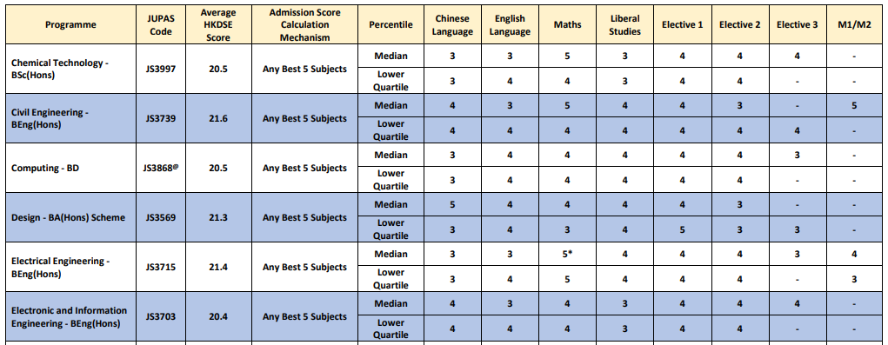
Entry Requirements
JUPAS 成績要求
2018
2019
2020
2021
Preferred subjects: Phy, Chem, Bio, ICT, M1/M2

Slide 4
3 Areas of Study in EIE
Electronic Systems & IoT (電子系統及物聯網)
Artificial Intelligence and Information Engineering (人工智能及資訊工程)
Information Security (資訊保安)

Slide 5
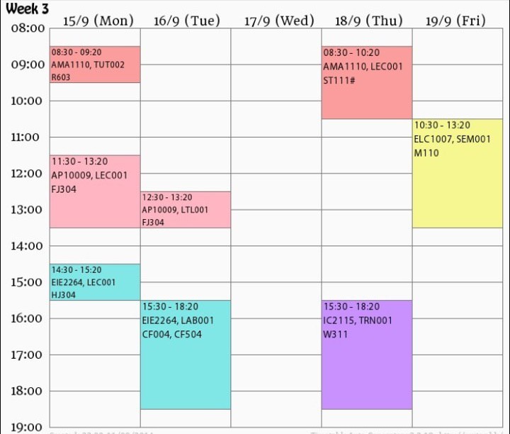
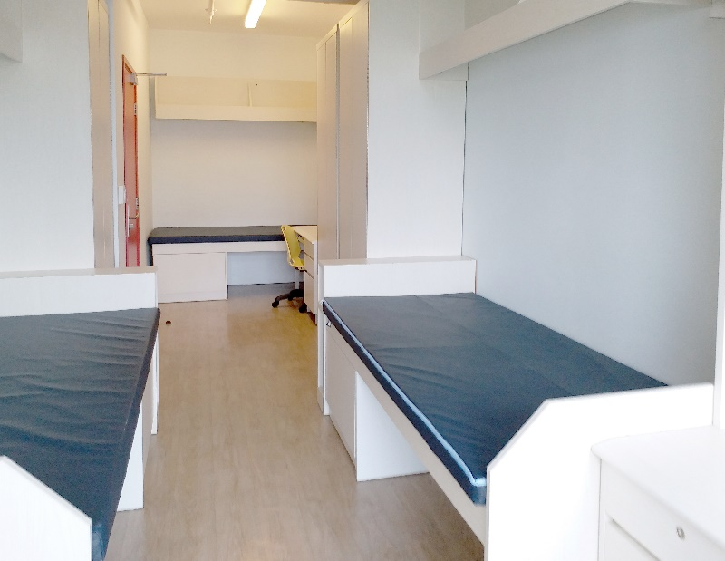
大學生涯
學習與生活模式 :
天地堂 (半日) (三日)
課外活動 (Soc)
HALL

Slide 6
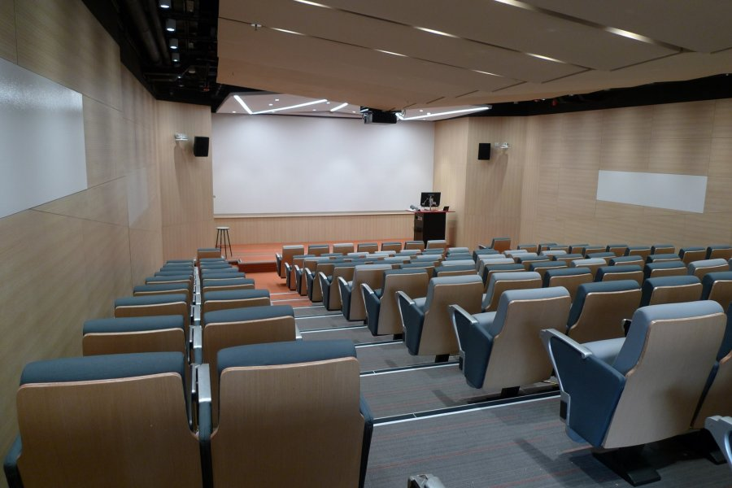
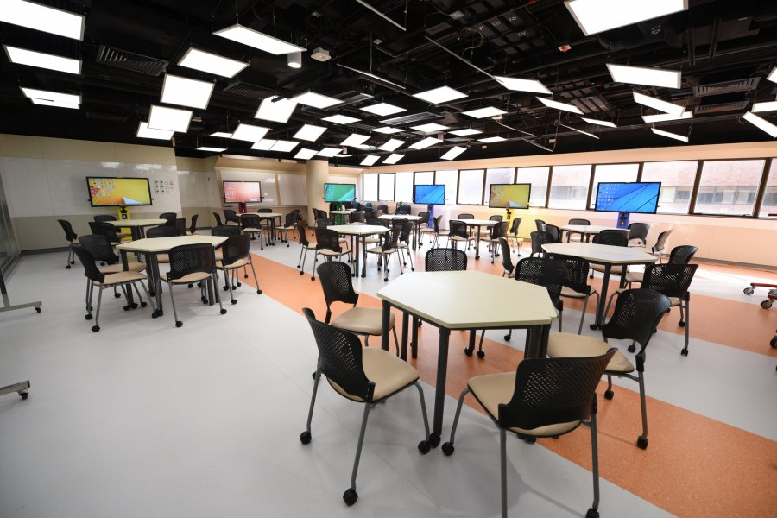
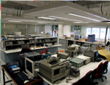
大學生涯
學習模式
Lecture Tutorial Laboratory

Slide 7
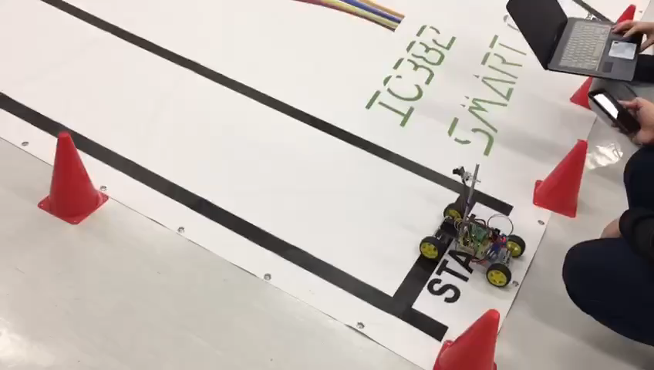
Electronic Systems & IoT

Slide 8
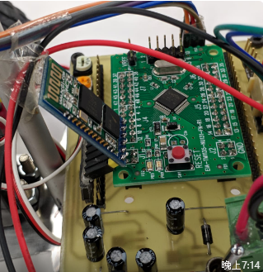
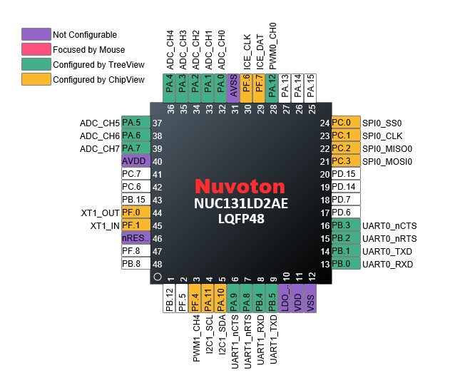
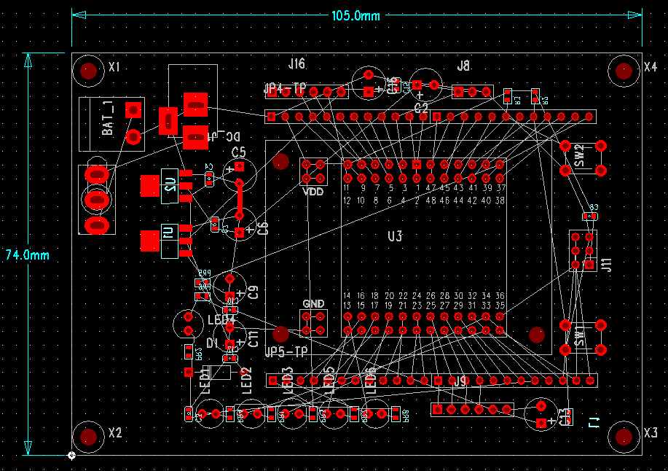
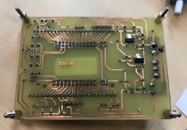
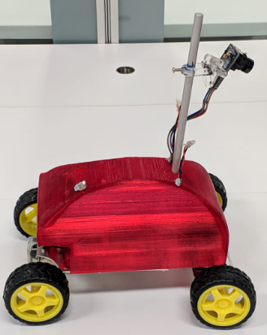
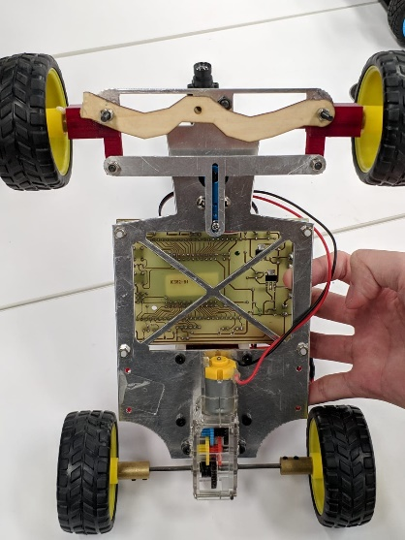
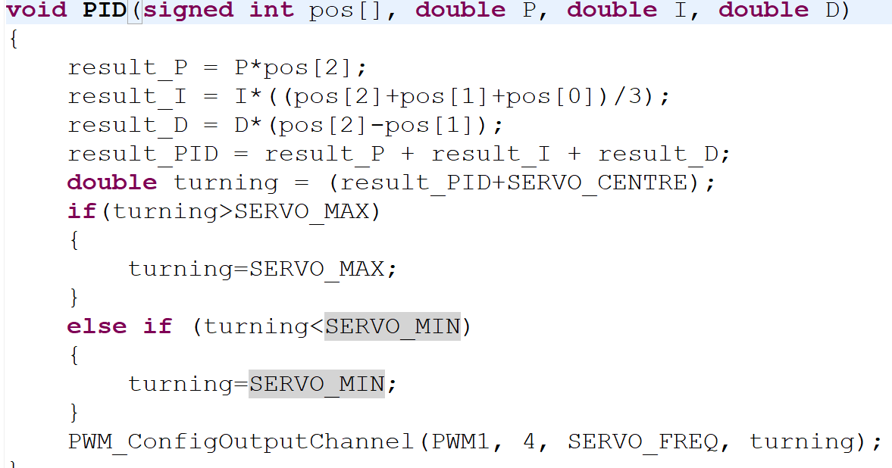
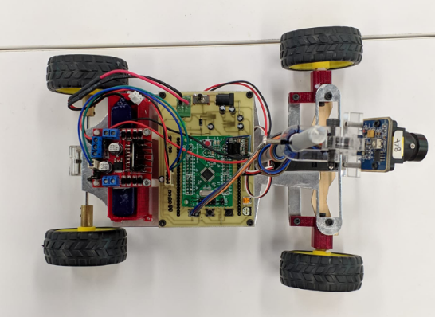
Electronic Systems & IoT

Slide 9
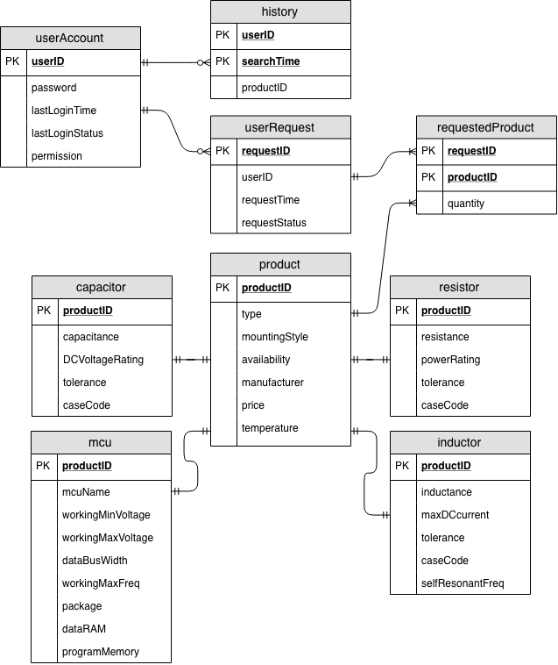
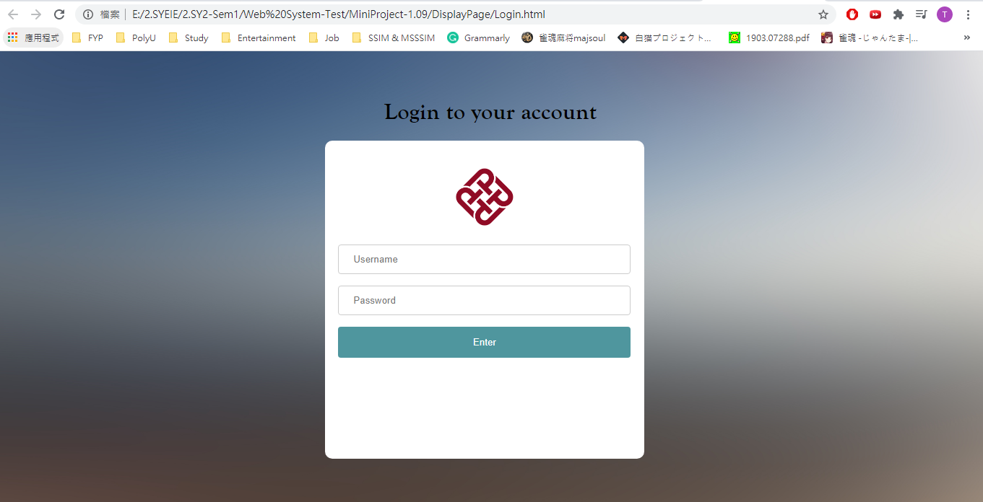
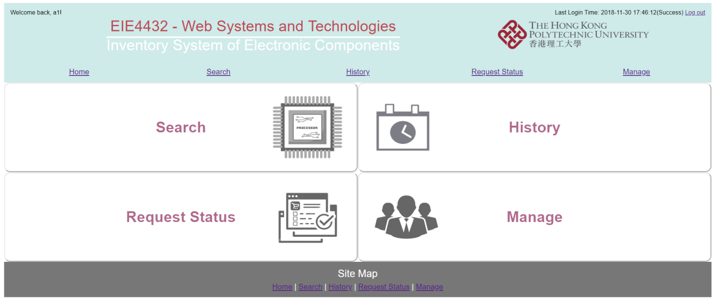
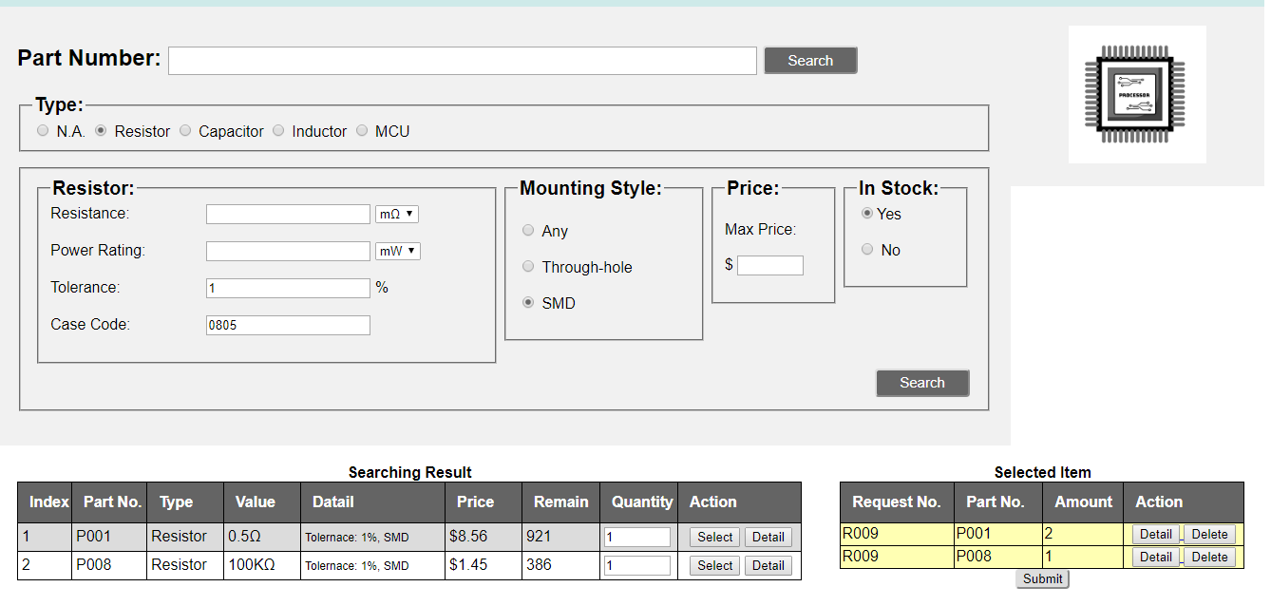
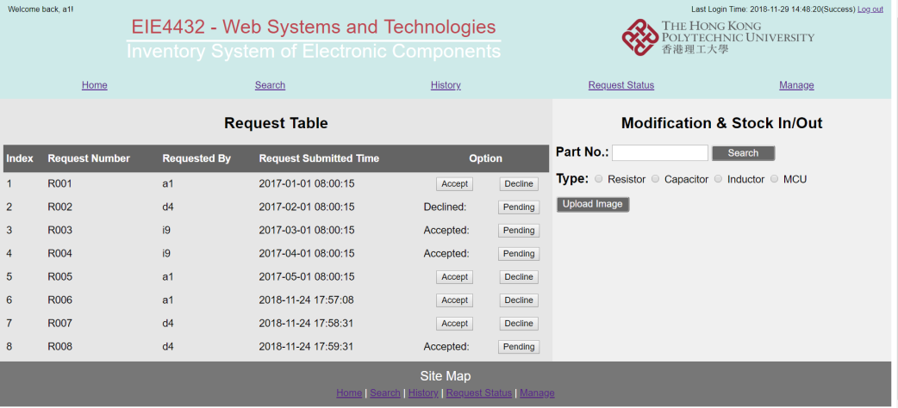
Artificial Intelligence and Information Engineering
設計一個網頁比公司存貨/貨倉清單

Slide 10
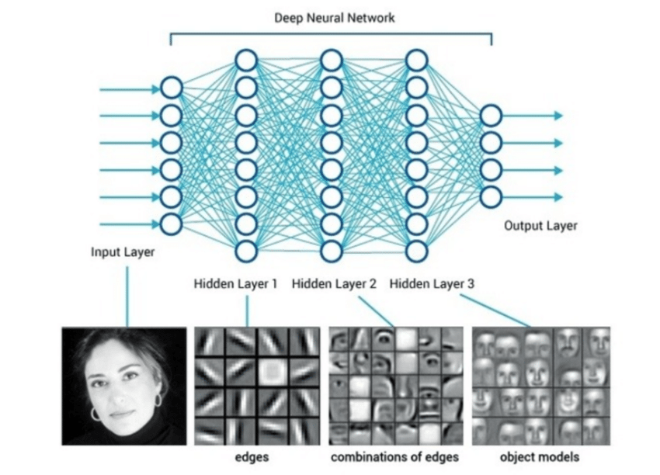
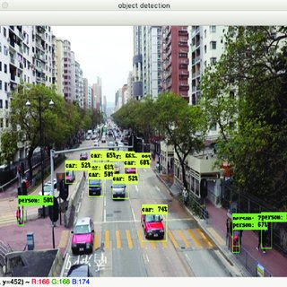
Artificial Intelligence and Information Engineering
人臉識別和物件識別

Slide 11
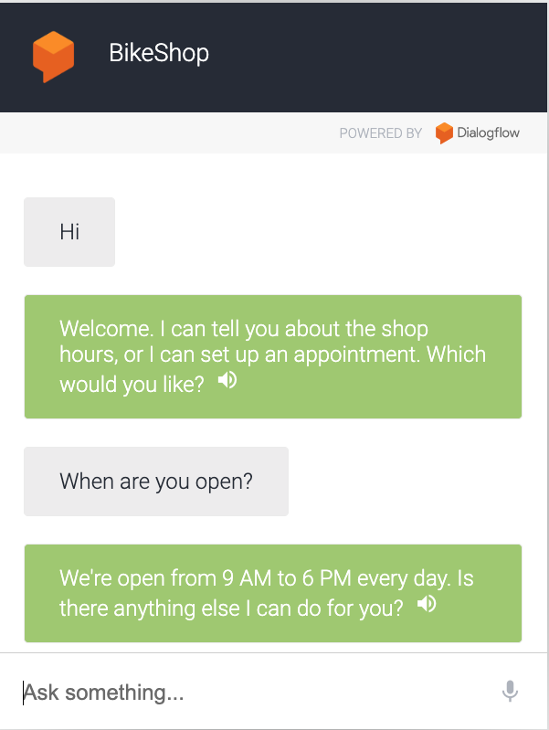
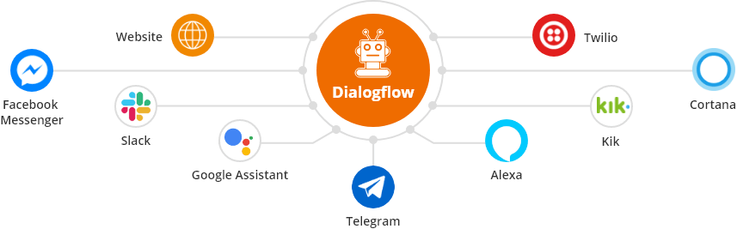
Artificial Intelligence and Information Engineering
聊天機器人 (ChatBot)
Messenger, Telegram, LINE, etc.

Slide 12
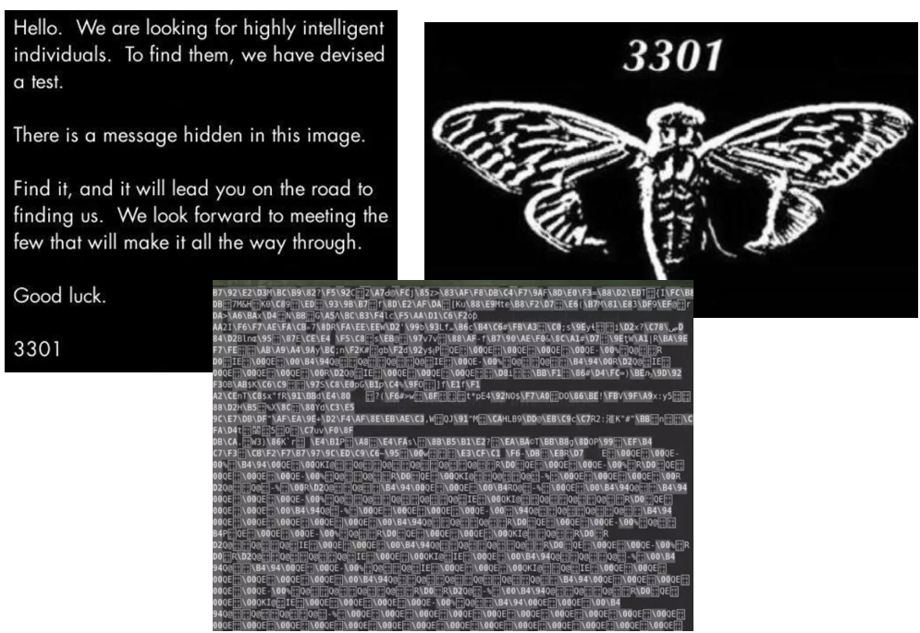



Information Security
信息加密
Information

Slide 13
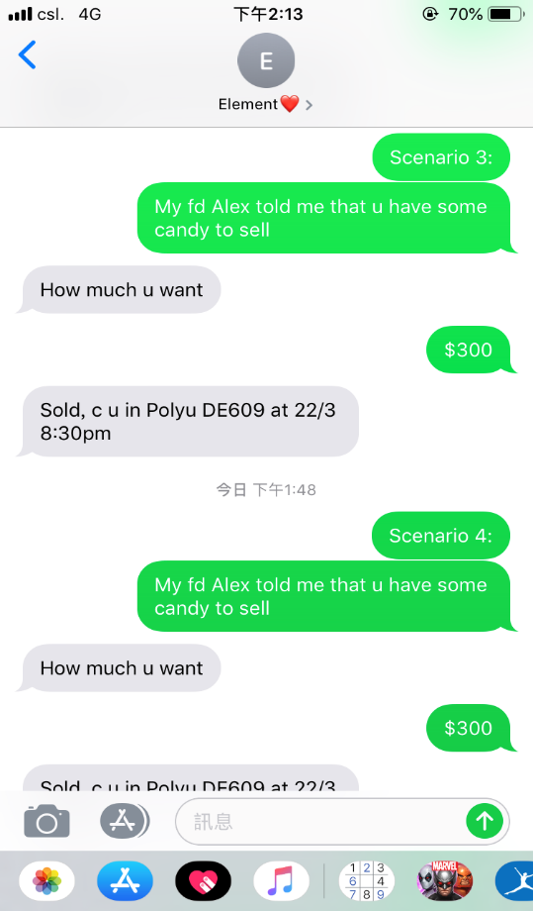
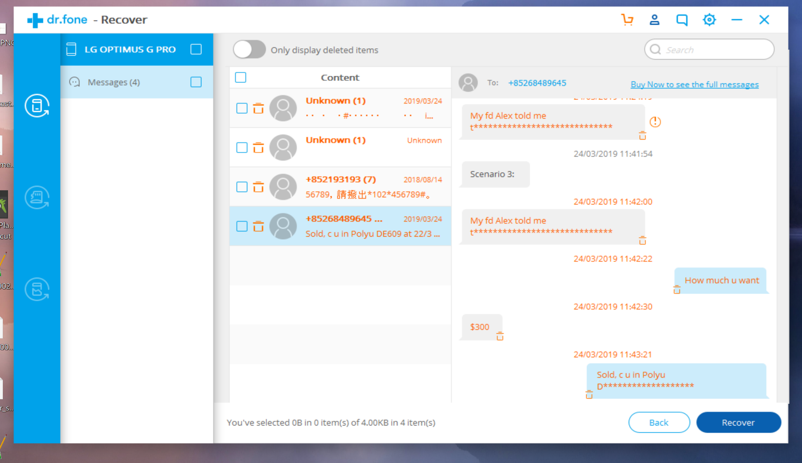
Information Security
Spam Detection

Slide 14
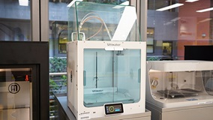
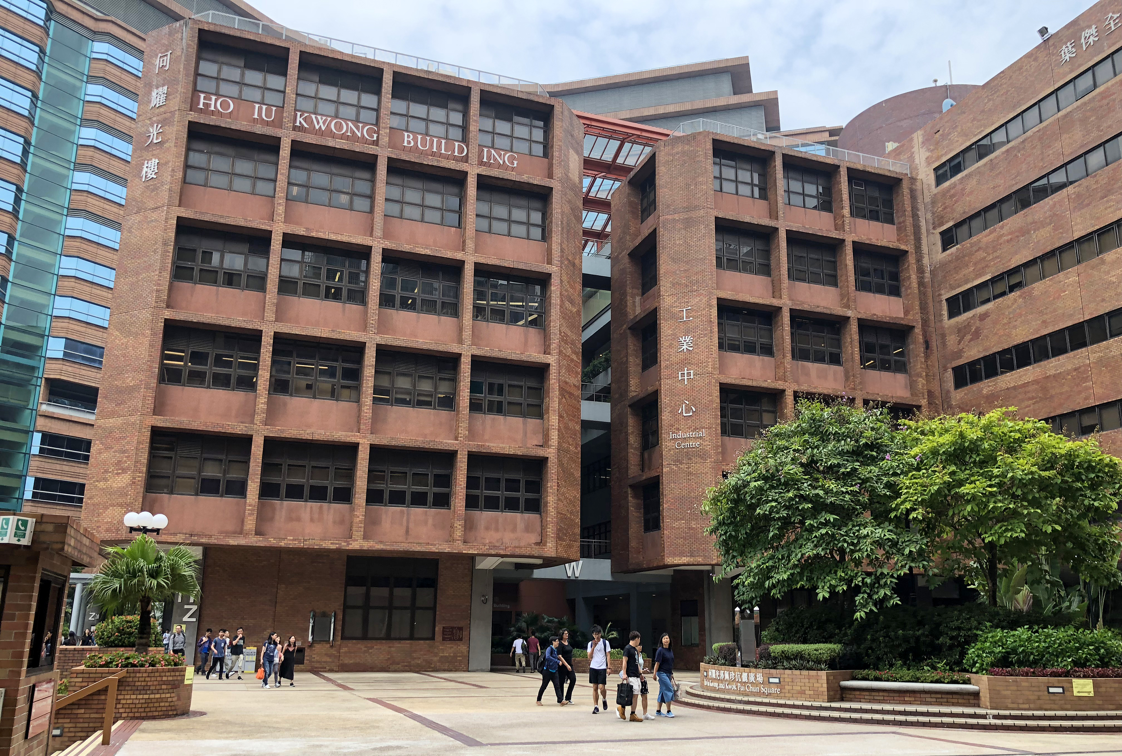
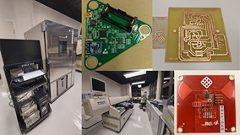
Industrial Centre Training (IC Training)
電路板 (PCB) 設計與製作
3D Printing

Slide 15
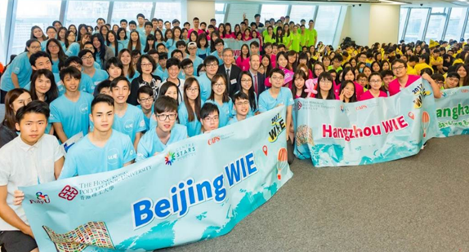
Work-Integrated Education (實習)
Mainland WIE
Taiwan WIE
International WIE
Local WIE

Slide 16
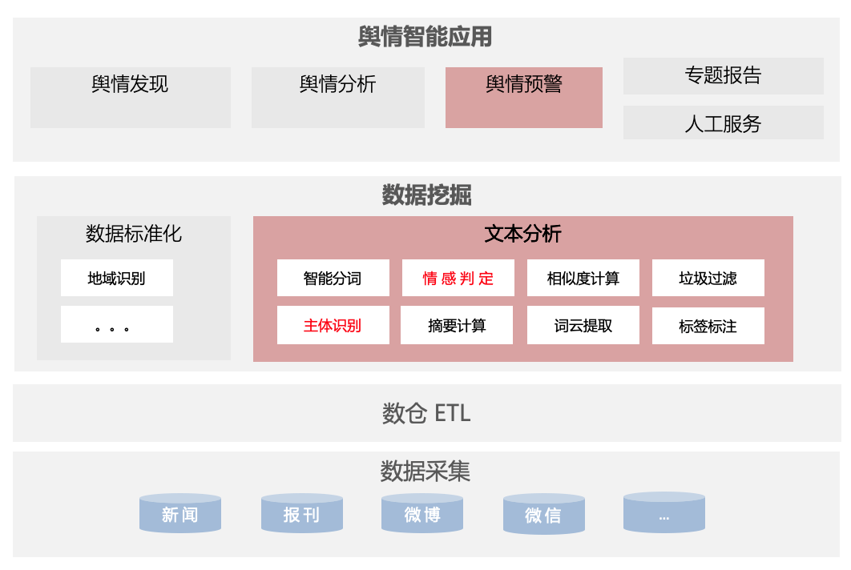
How EIE prepared for My Career Path
1 Year Full-Stack Engineer in a Startup
Programming Skill Sets (編程能力)
Python for automated job and AI projects
JavaScript for web development in both Frontend and Backend
SQL for Big Data Storage in Cloud Environment (AWS)
Profession Communication Skills and Team Work
Effective English communication in both spoken and written skills
Work with people across countries (Mainland, Singapore, etc.)

Slide 17
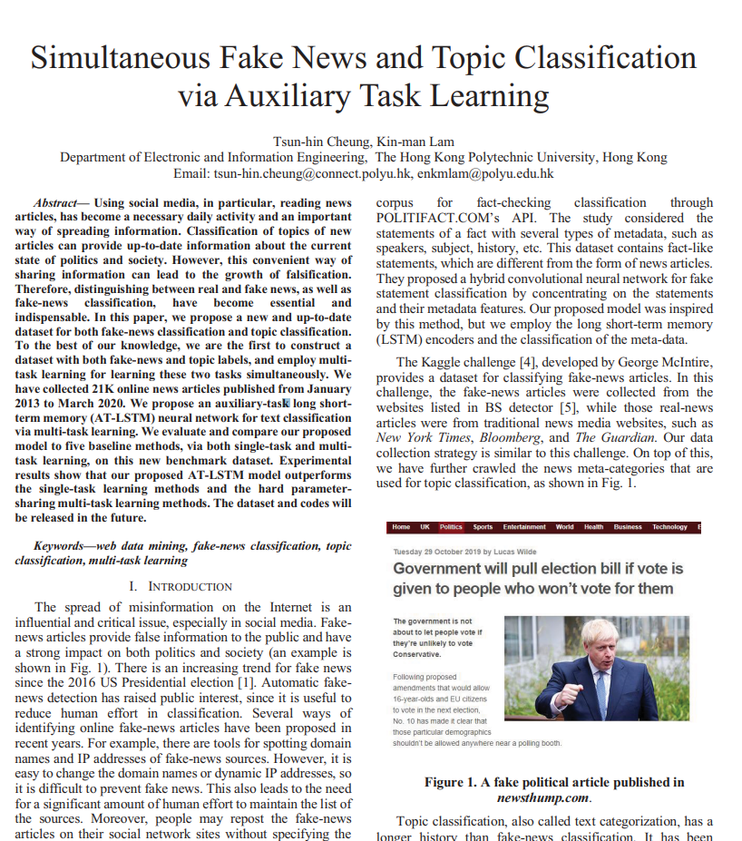
How EIE prepared for My Research Study
Professional Academic English (英文能力)
Reading and Writing Research Papers (learnt in Final Year Project)
Academic Presentation Skills (taught in Professional English Courses)
Solid Problem Solving Skills (解決問題能力)
Independent Problem Solving Mindsets (learnt in Final Year Project)
Programming and AI (learnt through years 2 - 4)

Slide 18
Job and Further Study of My Classmates
Career Path
Firmware Engineer at ASTRI, Hong Kong (科學園)
Software Engineer at Shopee, Singapore (蝦皮購物)
Academic Path
Study PhD at University of Toronto, Canada (加拿大多倫多大學)
Study PhD at Georgia Institute of Technology, US (美國佐治亞理工學院)

Slide 19
Thank You

Slide 20
Q & A

